Slide 1
Collecting French Smart Meter Data for Residential Flexibility
Benoit Couraud – Pierre-Jean Barre – Roberta Pennucci – Yann Rozier - Sonam Norbu - David Flynn – Erwin Franquet
University Nice Côte d’Azur - University of Glasgow
Paper №: A9157
1 / 2

Slide 2
Introduction
Energy Transition and gas-electricity prices evolution
⇨ residentials move from Gas heating to Electric
⇨ they request for a power rating increase
Challenge: Distribution System Operators cannot easily increase Residentials power rating

Slide 3
⇨ Residential Flexibility could help deferring the grid reinforcement
2 / 2

Slide 4
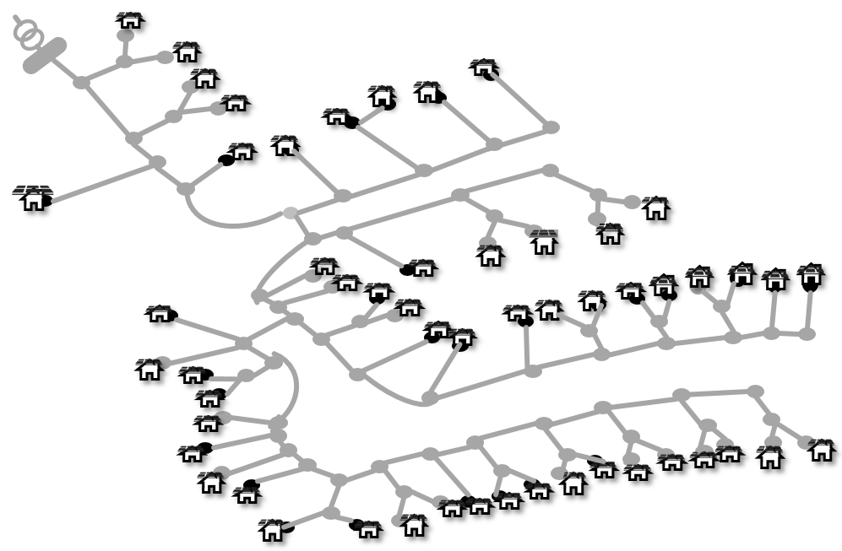
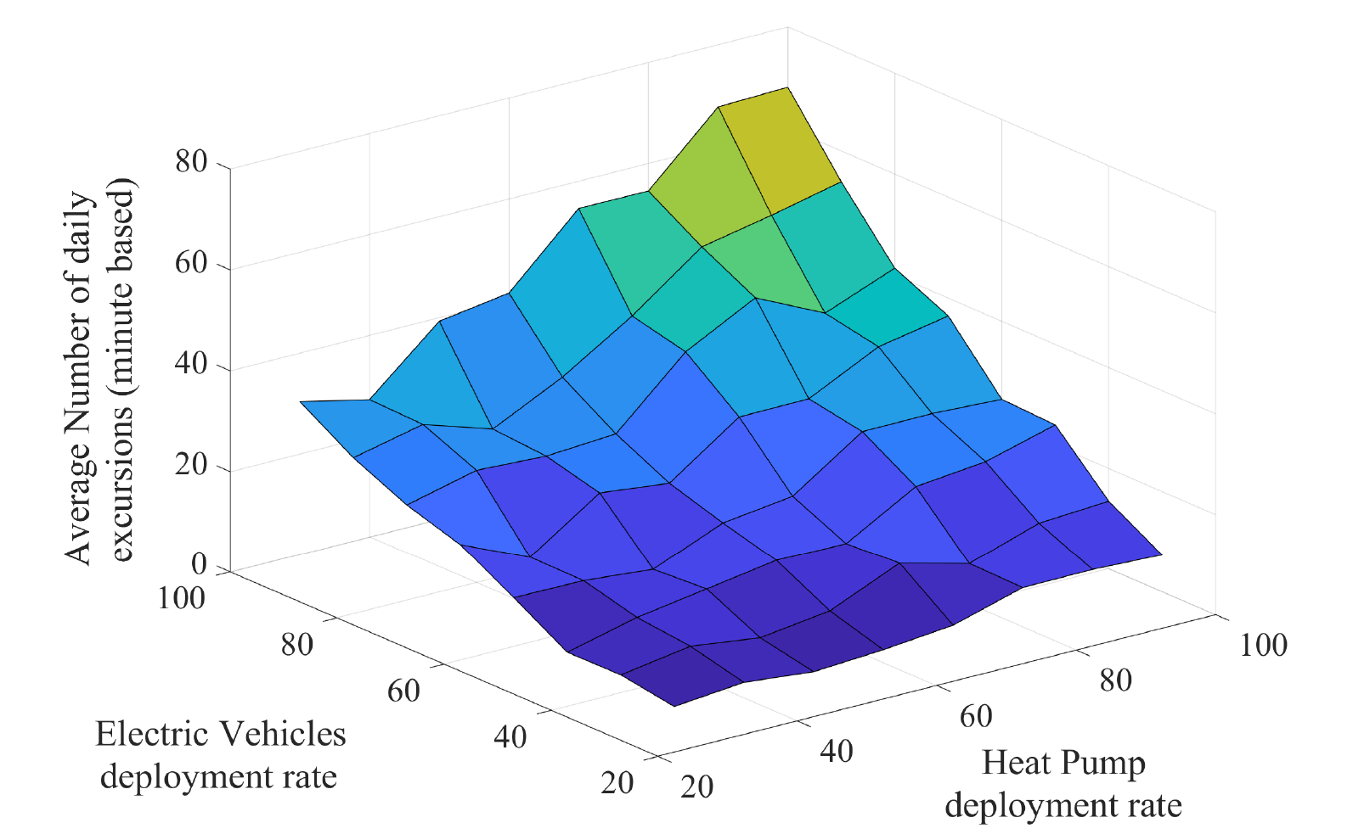

Similarly…
How EV roll-out will affect local grid?
Low Voltage European Reference Network
(~ 55 households)
Simulation results: Number of voltage excursions due to EV and HP penetration
Monte-Carlo random allocation of EV roll-out using EV charging profiles from My Electric Avenue large scale experiment

Slide 5
⇨ Residential Flexibility could help deferring the grid reinforcement
2 / 2

Slide 6



Residential Flexibility
Shifting of energy usage to prior / future times to reduce energy cost / avoid disconnection / …
Can be done through smart appliances – smart controller or … using a device connected to the Smart Meter ?

Slide 7
⇨ Leveraging the French Smart Meter to enable Residential Flexibility ⇨ We proposed a device that:
Switch off Flexible Applicances
Get Power/signals from the mains (smart meter)
If signal or
P > P_{threshold}
Send request to switch off smart appliances
2 / 2

Slide 8

French Smart Meter
Disconnects household if overall power greater than rated power
Collects load data and publish it every 30 min (next day publication) through PLC
Local data available at a higher frequency (> 3s) through custom protocol (~modulated UART) + very small local supply (< 130mW)
⇨ Concept = monitor data in real time and disconnect specific loads (Evs, water heater) when overall power increases dangerously

Slide 9
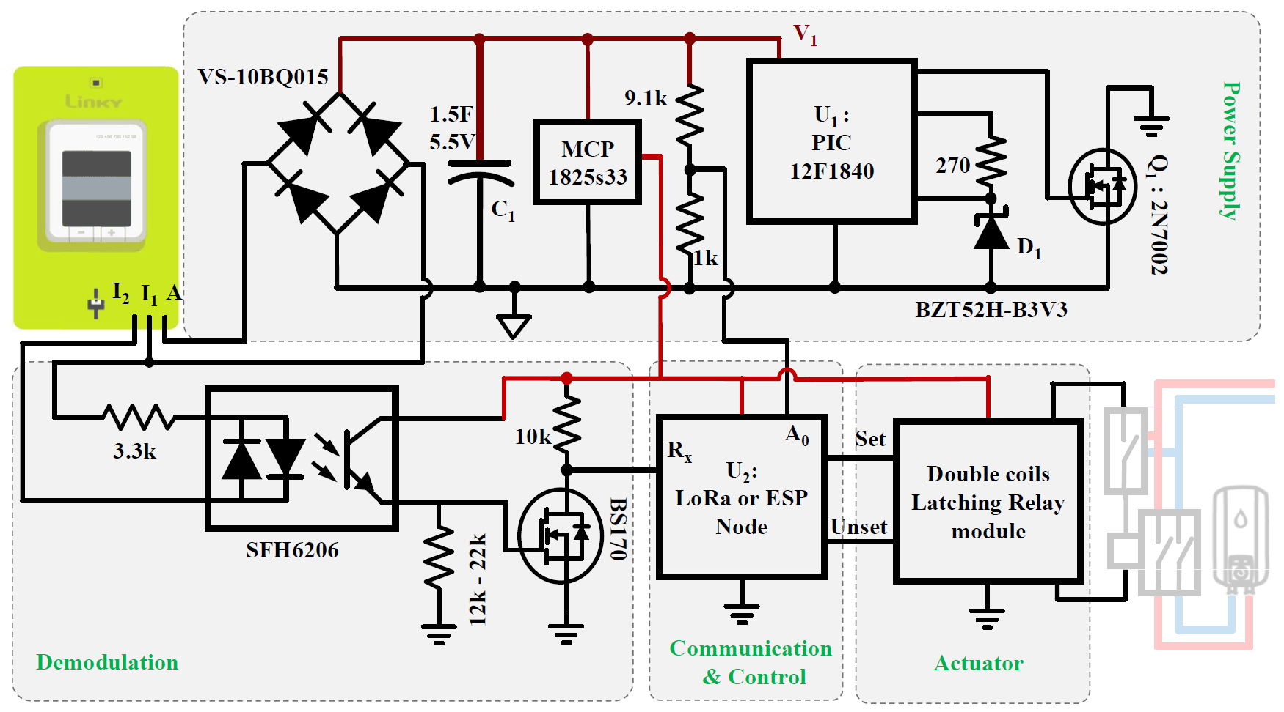
Connecting to the French Smart Meter
Power Supply
Demodulation
Communication
& Control
Actuator

Slide 10
Connecting to the French Smart Meter
Power Supply
Demodulation
Communication
& Control
Actuator

Slide 11
Connecting to the French Smart Meter
Power Supply
Demodulation
Comm
& Control
Actuator

Slide 12
Connecting to the French Smart Meter
Power Supply
Demodulation
Comm
& Control
Actuator

Slide 13
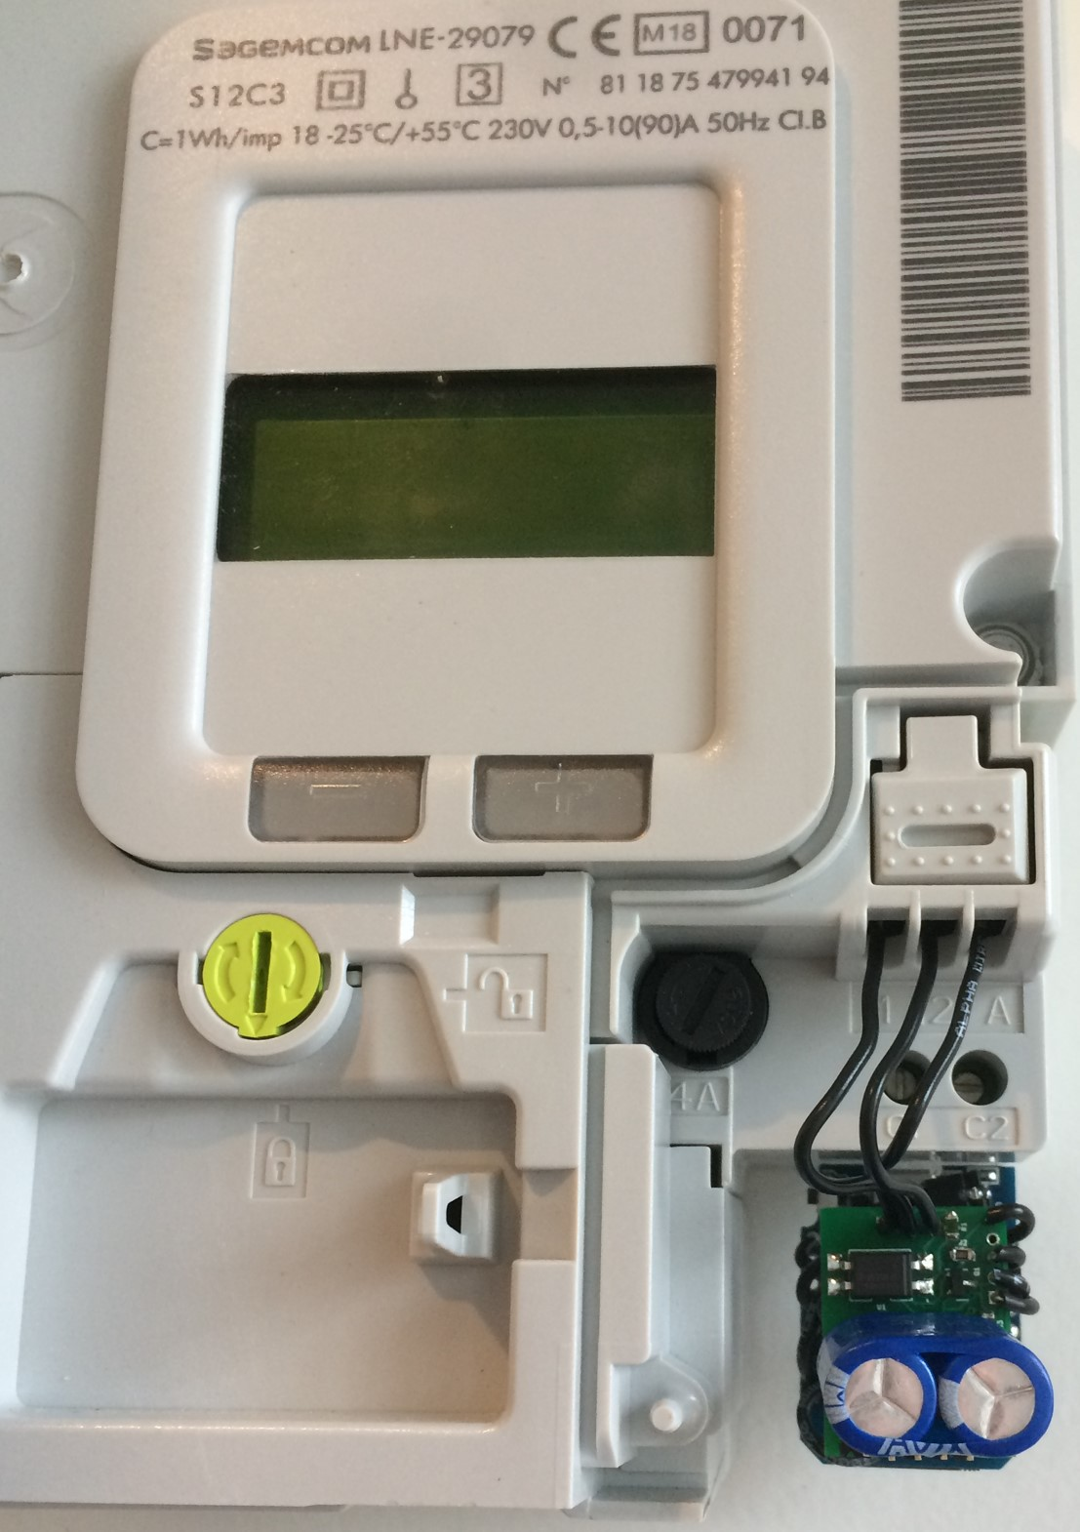
Connecting to the French Smart Meter
Power Supply
Demodulation
Comm
& Control
Actuator

Slide 14

Challenge: Power Supply Strategy
Very low power supply from the Smart Meter
Switch on Controller
V_{cap}
V_{threshold}
Controller
Supply Controller 1
V_{cap}
Send data
Sleep
Send data
Sleep
time
Supply Controller 1 switches on

Slide 15
Experimental Results
2 / 2

Slide 16
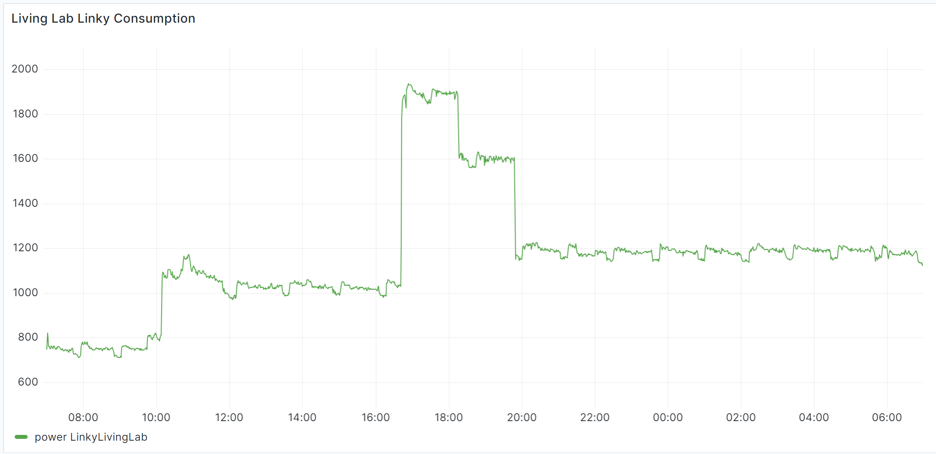
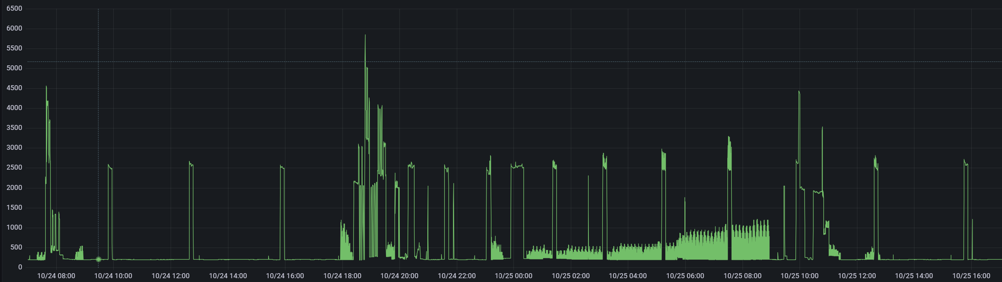
Experimentation
Successfully installed in 6 Households with correct switching behaviour when overloading
Also used for other purposes…

Slide 17
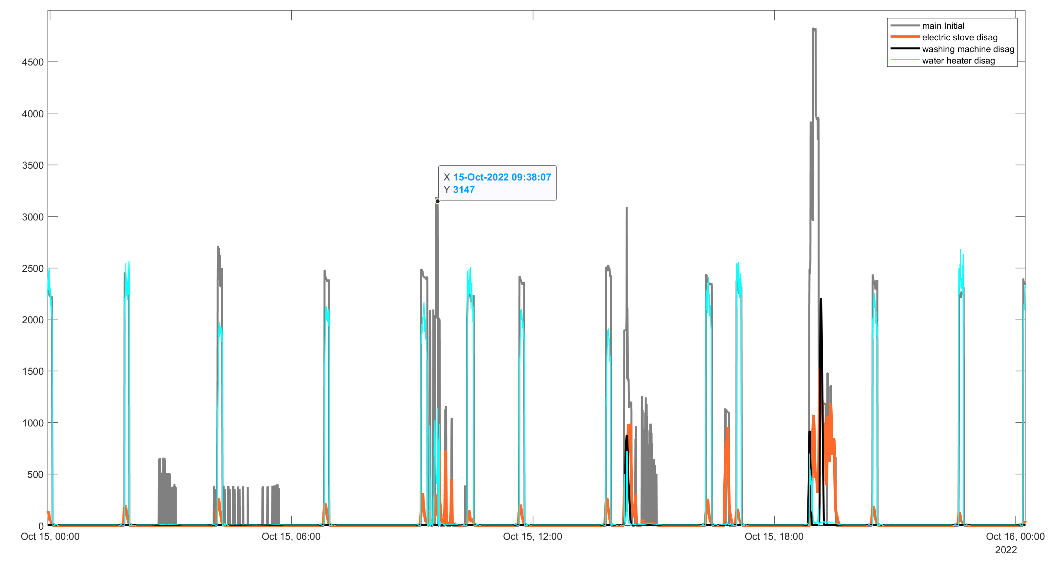
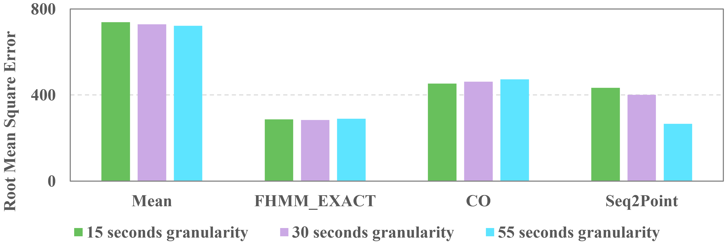
Leveraging Smart Meter Data
Residential Non-Intrusive Load Monitoring from Smart Meter Data
4.5
Main power
Electric Stove disaggregation
Water heater disaggregation
3
Power (kW)
1.5
0
Oct. 15 00:00
Oct. 15 06:00
Oct. 15 12:00
Oct. 15 18:00
Oct. 16 00:00

Slide 18
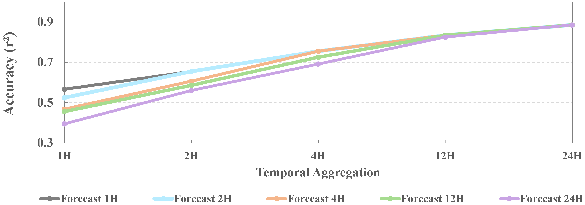
Leveraging Smart Meter Data
Residential Load Forecasting Assessment study

Slide 19
Conclusions
Successfully provided a small device to collect data and activate flexible appliances → open access: https://github.com/bcouraud/Linky-TIC-Reader
Smart Meter data has potential for NILM → need more datasets
Smart Meter Data for single house’s load prediction can be used but accuracy > 70% only if temporal aggregation > 4h
2 / 2

Slide 20
Thank you !

